Slide 1
NANO
Science·Material·Application·Technology
段力
2015.4

Slide 2
Out line
NANO = Science + Material + Application + Technology
NANO – the future

Slide 3
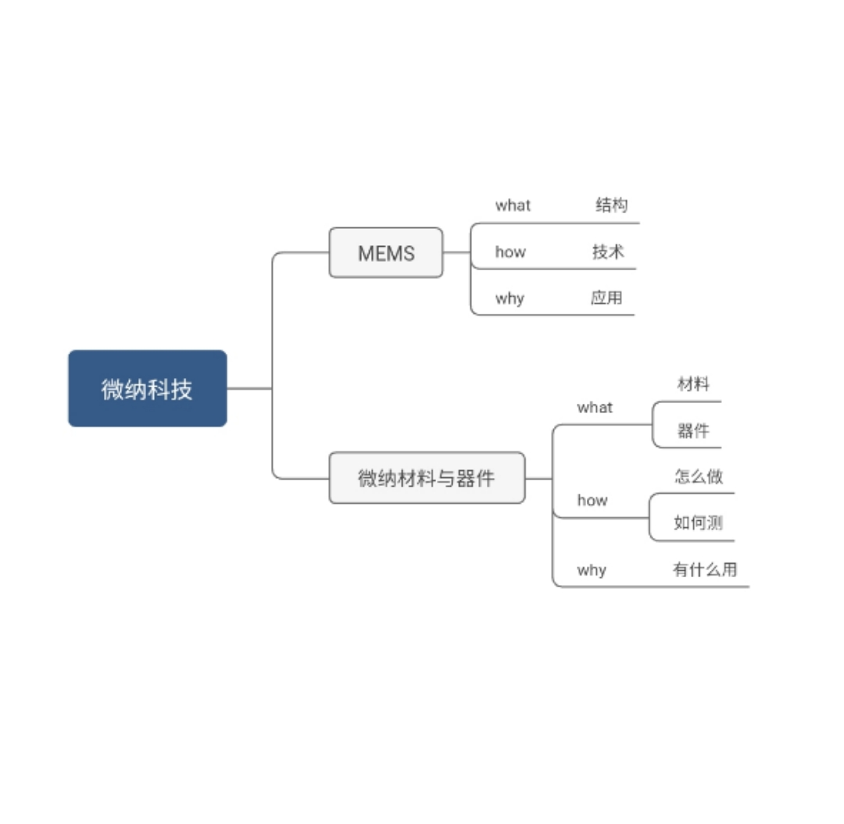
上海交大微纳院

Slide 4
NANO : 1-100nm
NANO: multi-disciplinary
NANO: New world
NANO
Theory
Technology
Material
Application (MEMS)
Notes:
微电子工业的一个副产品：微纳米加工，他山之石。

Slide 5
NANO in a glance
NANO is:
  NANO is the study of
  1-100 nm range
  NANO is a multi-disciplinary
  NANO opens a new world
4 main aspects:
  Science / theory
  Material
  Application
  Technology
Notes:
微电子工业的一个副产品：微纳米加工，他山之石。

Slide 6
NANO: Science
Multi-discipline
    Physics + Chemistry + Biology + ··· + IC Technology
Computer simulation:
    Models：Multi-physics, Poisson equation, Schrodinger equation
    Application: Quantum structures, 3D, MEMS
    Tools: COMSOL，Pisces, ATLAS , Cadence

Slide 7
NANO : 1-100nm
NANO: multi-disciplinary
NANO: New world
NANO
Theory
Technology
Material
Application (MEMS)
Notes:
微电子工业的一个副产品：微纳米加工，他山之石。

Slide 8
Nano Material
什么是纳米材料？有人简称为0D,1D,2D,3D, 也就是至少在一个维度上，尺度在1nm – 0.1mm之间的材料。
纳米点、纳米线、薄膜、纳米粉体颗粒\纤维（比表面积大, specific surface area (SSA), 100-1000 m^2/g）
Notes:
硅，沙子，大自然，便宜，硅衬底是~700um厚，backgrinding ~100um, 主要是表面的一层薄膜是工作区（1um内）,引进新材料不算太贵
材料的复杂和简单，门捷列夫周期表，没有一个原子是独立存在的，同一种原子的不同结构组合-不同的材料-不同的性质。
碳：金刚石，石墨，C60，碳纳米管微纳米，微纳米管，CNT Sumio Lijima 1991 NEC 飯島 澄男
包含了新的科学思想，水的主观实验，江本胜博士几十万次的反复试验，实事求是，反驳的专家，却只是空谈理论，或者用自己的见解来怀疑，并没以“事实说话”。爱因斯坦，科学的主观世界，正电子的发现， http://club.kdnet.net/dispbbs.asp?boardid=1&id=8140362&page=1&1=1#8140362 http://zh.wikipedia.org/wiki/%E7%A2%B3%E7%BA%B3%E7%B1%B3%E7%AE%A1

Slide 9
NANO: Material
Nanometer material may have distinct physical / chemical / etc, behaviors, Such as carbon nanotube (CNT), gold, Si/SiO2 and various hetero junction interface

Slide 10
NANO: Material - thin film
Most of the devices just use the top layers (~um) to fulfill their functions,
expensive substrate is a waste,
  例子。SOI, 镀金的首饰。
Thin film technology offers a cheaper way to make use of various expensive bulk materials
薄膜技术：微电子技术为引进新材料带来可能
  硅衬底 + 薄膜：Au, Ti, IIIV, IIVI, 锗, SOI, HKMG, Salicide, Cu , Low K，...

Slide 11
NANO: Material -酒瓶新酒
同一个元素\不同的视角
  门捷列夫与微纳米，同一种原子、分子，不同的组合方式 =》
  例如，C材料, 之前只有石墨和金刚石, 现在有了石墨烯和碳纳米管。它们的元素符号都是c。但是由于组合的不同，就形成了新的物质。

Slide 12
Nano：material→ C
金刚石 + 石墨 +富勒烯C60，
石墨烯 + 碳纳米管（英文Carbon Nanotube，缩写CNT）日本 物理学家 饭岛澄男 （ Iijima Sumio ）

Slide 13
C -石墨烯（Graphene）

Slide 14
C- CNT
碳纳米管
英文Carbon Nanotube，缩写CNT
日本 物理学家 饭岛澄男 （ Iijima Sumio ）

Slide 15
再下边材料就应该是
水

Slide 16
NANO : 1-100nm
NANO: multi-disciplinary
NANO: New world
NANO
Theory
Technology
Material
Application (MEMS)
Notes:
微电子工业的一个副产品：微纳米加工，他山之石。

Slide 17
Nano：Applications
MEMS
  MEMS (Micro Electro Mechanical System)
  Sensors, actuators
New Devices:
  CNT – man-made material
  CNT transistors, CNTFET
Energy, chemistry, civil:
  Lotus effect – very high water repellence of the leaves of the lotus flower
  Catalyst
  Fuel cell
... ...

Slide 18
Nano：Applications→MEMS
Micro
electronics
Sensor / Transducer
Micro
actuator
MEMS / SOC
  E: IC as a brain, M: as a hand.
  Sensor is to receive; actuator is to response
  Technology：borrow the IC technology
【 From/to 】 Temperature, optical, mechanical, chemical, magnetic signals
【To/from】An electrical signal

Slide 19
Nano：Applications→出淤泥而不染
周敦颐 《爱莲说》 「莲花出淤泥而不染」 为什么呢？
Lotus Effect 莲之所以出淤泥而不染的原因是莲叶的表面 奈米结构达到自洁的效果，如此表面自我洁净的物理现象称为『莲叶效应』！
科学家们模拟莲叶的表面，发明了纳米自清洁的衣料和建筑涂料，只需一点水形成水滴，就可以自动清洁衣物和建筑表面。

Slide 20
NANO : 1-100nm
NANO: multi-disciplinary
NANO: New world
NANO
Theory
Technology
Material
Application (MEMS)
Notes:
微电子工业的一个副产品：微纳米加工，他山之石。

Slide 21
Nano Technology
Most from IC industry
4 basic steps (repeating)
  Draw
  Add
  Remove
  Modify
Notes:
技术 应用 = > 将自己的所长与经历
用于要用的领域
纳米MEMS

Slide 22
Nano Technology
Draw – using photolithography to draw a pattern of pictures
    Light, exposing
    Mask, patterning
Paint – using the pattern to add, remove or change the material selectively
    Add: thin film deposition, epitaxy, thermal growth,
    Remove: wet etching, plasma etching, CMP
    Modify: ion implantation, alloying, saliciding
Notes:
技术 应用 = > 将自己的所长与经历
用于要用的领域
纳米MEMS

Slide 23
Micro/nano process
在薄膜淀积之后，
在表面涂一层光刻胶（PR），
然后光线（Light）透过光刻版（Mask）对硅片进行曝光（Light Exposure）、
显影（Developing）、
烘干(Baking)
之后进行刻蚀（Etching），
除去光刻胶之后，就在薄膜上得到了所需要的图案

Slide 24
Micro/nano process

Slide 25
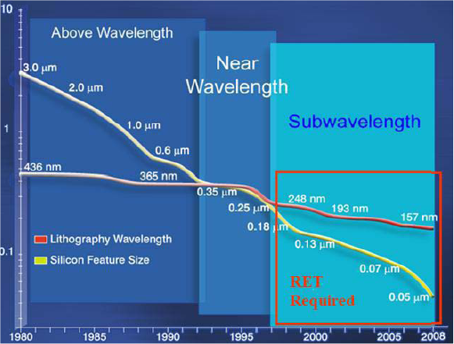
Nano Technology: Photolithography
Reducing the size for the past 30 years
Notes:
Chart from Dr. Danny Rittman, Line 28nm, CD control, 4nm, field size 25x52, 28 masks, MEMS may not need highend photolithography
Next Generation Lithography deep ultraviolet 193, 157nm, Extreme ultraviolet, 13.5nm,power too slow, DPT: Double Patterning Technology
Source: http://www.design-reuse.com/articles/24046/in-design-physical-verification.html S. Borkar, “Design challenges for gigascale integration,” presented at the 37th Annu. IEEE/ACM Int. Symp. Microarchitecture, Portland, OR, 2004.

Slide 26
Reducing the size , why?
Cost
Yield
More function
Notes:
0. wafer has a line cut, 1. Shrink the die size, 2. wafer, 700um tickness, several 10 um after dicing, from 150mm 200mm 300mm, 450mm, 6”, 8” 12”, 18”, 3. field size = 26x52 mm^2, lattice FPGA 3x3mm^2, AMD 2x2 cm^2,

Slide 27
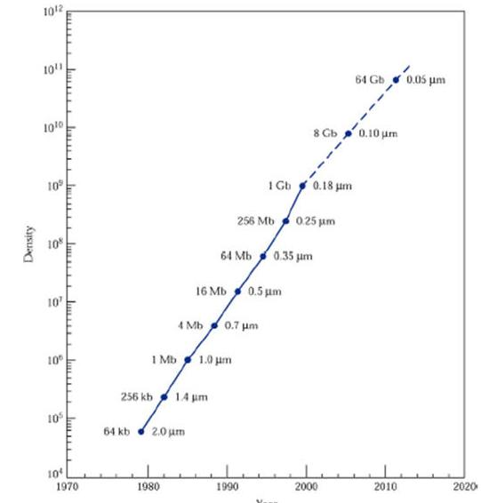
摩尔定律-集成技术发展进度法则
MOSFET 的数量和年呈指数增长
  1millionX / 30yrs • 2X / month • 64K-64G
  K:10³, M:10⁶, G:10⁹
MOSFET, 2um – 0.050um, 等比例定律, Scaling Down Rule
经验曲线
MOSFET 的数量
年
Notes:
Experimental, fairly accurate and no logic,
Scaling Down Rule later slide ...
Fact frst, explain why in later slides
2e10= 1k, 20 1m, 30 1g

Slide 28
Nano Technology: Thin film deposition
Methods:
  PVD, CVD
  Epitaxy
  Thermal
Criteria:
  Uniformity, quality, defects, step coverage, deposition rate
Materials：
  Base material, Si
  Optical (LED, Solar) ,Magnetic (Compass), Stress (Strained Si)
Notes:
two types of deposition: physical and chemical
MOCVD, metal organic, Wide application ,Lasers, LEDs, solar cells, photodetectors, HBTs, FETs.
sputtering, plasma, RF http://www.memsnet.org/mems/processes/deposition.html

Slide 29
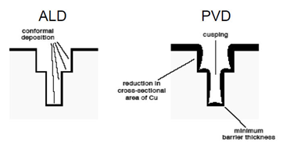
ALD: delicate thin film growth
Better thickness control
Better 3D coverage
Notes:
From Krishna Saraswat, Stanford, 2009

Slide 30
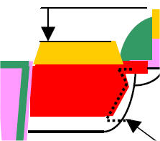
Nano Technology: etching
【Wet etching】easy, hard to control lateral
【Dry etching】ion + chemical, < 0.1um patterning
【Damascene】CMP, hard to etch Cu, Metal Gate
【3D Shaping】Σ shape patterning, SiGe
isotropic vs. anisotropic,
{111} < {110} < {100},
selectivity,
etch rate,
Notes:
化掉，与，切掉， Wet Etch Crystalline Materials: etching rate is typically lower on the more densely packed surface than on that of loosely packed surface(100){110}{100}{111} Si: Diamond Lattice Structure {111} > {100} > {110}
Damascene: 1D design rule, CMP,
Dry selectivity low

Slide 31
Nano Technology: modify the material
Ion implantation, annealing
Salicide, sputtering, alloying
Post processing
  FPGA
  Flash
  ROM, Fuse, anti-fuse
Notes:
Fuse: high current -> open, antifuse, metal/poly/Si, high voltage -> alloy = conducting

Slide 32
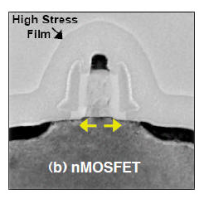
FEOL: smaller and smaller “T”s
Silacide
Si3N4
Poly Si
Buffer Oxide
Silacide
Si Substrate
Notes:
Mosfet From simple to complex (原因是SCE), 2. visible vs invisible (doping, stress, ..), 65nm technology,
short channel effect SCE, Vt roll off, doping,
stress engineering tpen cpen SiGe strained silicon
sti edge (thin ox mosfet),sti stress (compressive), reverse narrow cchannel effect, lod
STI affects the mechanical state and electrical performance of neighboring transistors, motivating the need to analyze and model its impact during technology development and design. This article presented TCAD simulations of two such prominent cases: the narrow-width effect and stress proximity effects. In the narrow-width effect, STI contributes to variation of the channel doping and stress, with the combined result of a significant shift in the threshold voltage. Stress proximity effects are endemic to strained silicon technologies. The STI adds compressive stress to its adjacent silicon regions, and is summed with other stress sources to determine the overall stress state and electrical performance of individual transistors in the design.
Channel engineering techniques
Typically, channel engineering techniques, an effective method to improve device
performance, is accomplished by implants, which can also impact local sidewall doping

Slide 33
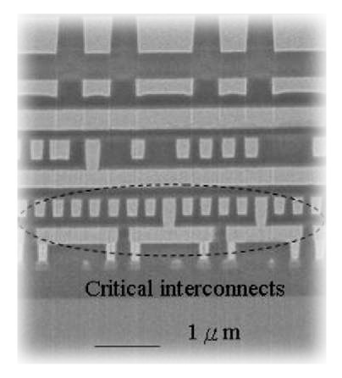
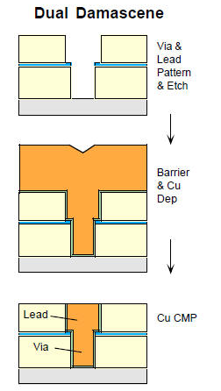
BEOL more and more “L”s
ILD
淀积/
刻沟
M2
Nitride
Cu
Via
Cu
淀积
Oxide
M1
Contact
Si
SEM of Copper Interconnect
CMP
磨平
Notes:
0. buffer layer liner Copper is sealed, 1. Dual damascene, 2. Cu and low K, not only the connect, but also isolate, 3. three levels of interconnect, M1-M2 local, M1 use expensive mask with mini CD, M3-M5 one way connect, M6-9 use thicker metal for higher current since it conduct a few lines below. M10-11 for Al bonding.

Slide 34
Out line
NANO = Science + Material + Application + Technology
NANO - future trend

Slide 35
Nano trend
Longer: 长度方向：科研
  新的纳米材料（0D、1D、2D），人造材料
  新的纳米物理、原理
  新的纳米器件、新纳米结构
  MEMS
Wider: 宽度方向：应用
  利用现有的微纳技术进行跨学科的应用
Notes:
正电子的发现，实事求是，严谨的科学态度，关于是否伪科学，江本胜博士进行了几十万次的反复试验，确信无误后，才到全世界到处演讲。反驳的专家，却只是空谈理论，或者用自己的见解来怀疑，并没以“事实说话”。关于水的实验，一切仁者见仁，智者见智了。爱因斯坦，科学的主观世界，打开心， http://club.kdnet.net/dispbbs.asp?boardid=1&id=8140362&page=1&1=1#8140362 http://zh.wikipedia.org/wiki/%E7%A2%B3%E7%BA%B3%E7%B1%B3%E7%AE%A1

Slide 36
Longer：physics
新材料
  启发，用最便宜的材料，做成最不平凡的事，就是使用自然界常用、便宜的材料，来造成革命性的变革。
  首先是Si，就是沙子，造成了现在的信息革命。
  然后是C，就是木头。碳：金刚石+石墨+C60+grephene+CNT，同一种原子、分子，不同的组合方式 =》新的材料，旧瓶装新酒。
  然后是 H₂O，水里面的内容是很多的，不仅包含了物质层次，也包含了意识层次。
新器件、新原理
新结构、MEMS
Notes:
正电子的发现，实事求是，严谨的科学态度，关于是否伪科学，江本胜博士进行了几十万次的反复试验，确信无误后，才到全世界到处演讲。反驳的专家，却只是空谈理论，或者用自己的见解来怀疑，并没以“事实说话”。关于水的实验，一切仁者见仁，智者见智了。爱因斯坦，科学的主观世界，打开心， http://club.kdnet.net/dispbbs.asp?boardid=1&id=8140362&page=1&1=1#8140362 http://zh.wikipedia.org/wiki/%E7%A2%B3%E7%BA%B3%E7%B1%B3%E7%AE%A1

Slide 37
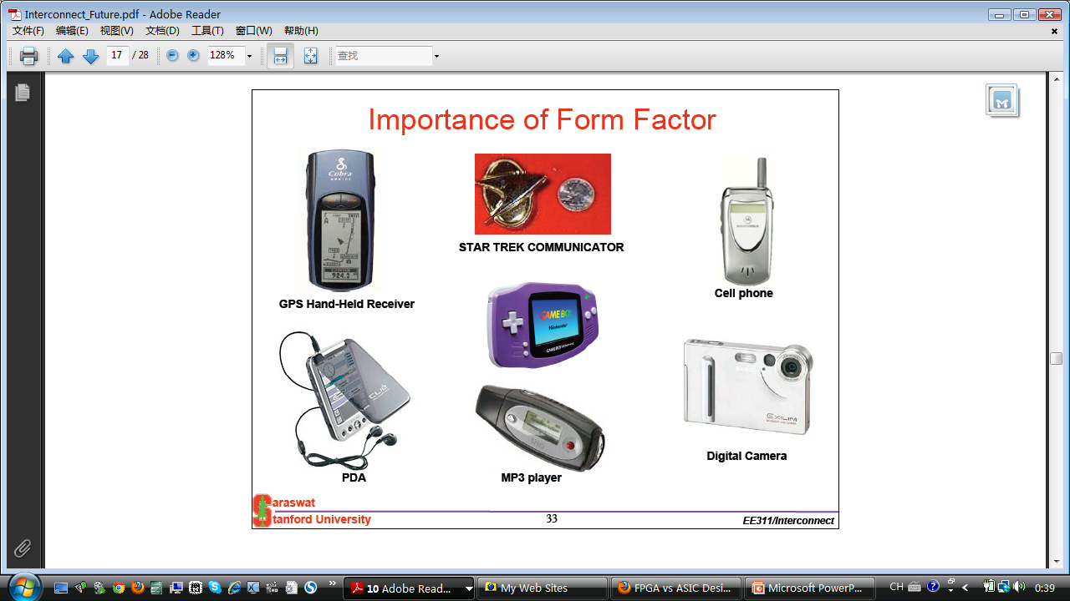
Wider：应用
这张图是2006年时候的图。那个时候图里面的这些东西还都是分立的元件。现在，他们都已经被集成了，就是现在我们的智能手机。
基本思路，科技人人白日梦。
也就是将自己的所长、技术与经历用于要用的领域 。

Slide 38
Summary
Nano is a multidicipilinary of Physics + Chemistry + Biology + nano Engineering
Nano has 4 main aspects: Science, Material, Application and Technology
3 main nanotechnologies ：photolithography, etching, and thin film, in the playground of nano/MEMS fabrication.
MEMS + SOC may offer a large application and market place to play.
Notes:
技术 应用 = > 将自己的所长与经历
用于要用的领域
纳米MEMS
Nano is a multidicipilinary of Physics + Chemistry + Biology + nano Engineering
Nano has 4 main aspects: Science, Material, Application and Technology

Slide 39
习题
Nano的4个方面？
Nano 跨学科？几个学科？
Nano Technology 的4个基本工艺？
“加法的”几种方法？
“减法的”几种方法？
Micro/nano process 的示意图？
缩减光刻尺寸对微纳工艺集成电路发展的三项基本贡献？
微纳学的未来发展的两种方向？

Slide 40
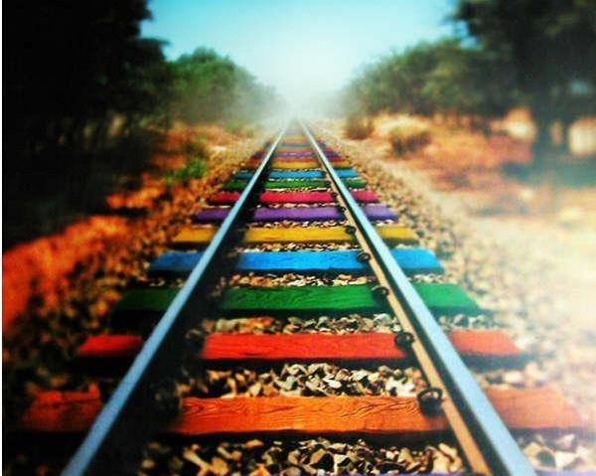
FIN
Thank you!
Notes:
Erli chen Fabrication III – Etching
pds_67_eight
http://www.memsnet.org/mems/processes/etch.html

